Slide 1
What is Programming?
Aspects of Programming, Computer Languages, Objects and Object-Oriented Programming
“I’m in the wrong class!”

Slide 2
Many Aspects of Programming
Programming is controlling
computer does exactly what you tell it to do – literal minded idiot savant
Programming is problem solving
always trying to make the computer do something useful
e.g., finding an optimal travel route
methodology is applicable to other fields
Programming is creative
must find the best solution out of many possibilities
Programming is modeling
describe salient (relevant) properties and behaviors of a system of components (objects)
Programming is abstraction
identify important features without getting lost in detail
Programming is concrete
must provide detailed instructions to complete task
Programming is a craft
a bit like architecture, engineering - disciplined and creative craft for building artifacts

Slide 3
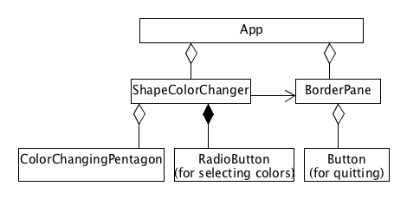
What’s a Program? (1/3)
Model of complex system
model: simplified representation of salient features of something, either tangible or abstract
system: collection of collaborating components

Slide 4
What’s a Program? (2/3)
Sequences of instructions expressed in specific programming language
syntax: grammatical rules for forming instructions
semantics: meaning/interpretation of instruction

Slide 5
What’s a Program? (3/3)
Instructions written (programmed/coded) by programmer
coded in a specific programming language
programming languages allow you to express yourself more precisely than natural (human) language
as a result, programs cannot be ambiguous
Real world examples
Banner, word processor, email, video game, ATM, smartphone, vehicles…
Executed by computer by carrying out individual instructions

Slide 6
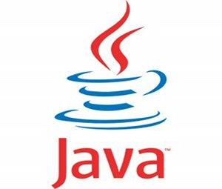
Java Programs
CS15 and CS16 use Java
Java was developed by Sun Microsystems (absorbed by Oracle)
the Sunlab was named for the desktop computers that it held for over a decade
it is meant to run on many “platforms” without change, from desktop to cell phones
platform independence
but Java isn’t sufficient by itself: many layers of software in a modern computer

Slide 7
The Computer Onion
Layers of Software
cover hardware like an onion covers its core
make it easier to use computers
organized into libraries and programs
hardware (PC)
Linux
Fast-X
In CS15, we only deal with the outermost layers
Your Java Program
Notes:
What to do with x-windows

Slide 8

Two Views of a Program
software layers hidden by user interface
user interface
user’s view
programmer’s view

Slide 9
Programming Languages (1/3)
Machine language
machine is short for computing machine (i.e., computer)
computer’s native language
sequence of zeroes and ones (binary)
different computers understand different sequences
hard for humans to understand:
01010001...

Slide 10
Programming Languages (2/3)
Assembly language
mnemonics for machine language
low level: each instruction is minimal
still hard for humans to understand:
ADD.L d0,d2
assembly language taught in CS33

Slide 11
Programming Languages (3/3)
High-level languages
FORTRAN, C, C++, Java, C#, Python, JavaScript, Scheme, Racket, Pyret, ML, OCaml, etc.
high level: each instruction is composed of many low-level instructions
closer to English and high school algebra
easier to read and understand than Assembly language
hypotenuse = Math.sqrt(leg1 * leg1 + leg2 * leg2);

Slide 12
Running Compiled Programs (1/2)
In CS15, code in a high-level language, Java
But each type of computer only “understands” its own machine language (zeroes and ones)
Thus must translate from Java to machine language
a team of experts programmed a translator, called a “compiler,” which translates the entirety of a Java program to an executable file in the computer’s native machine language.

Slide 13
Running Compiled Programs (2/2)
Two-step process to translate from Java to machine language:
compilation: your program executable
execution: run executable
machine executes your program by “running” each machine language instruction in the executable file
not quite this simple “underneath the covers” – “Java bytecode” is an intermediate language, a kind of abstract machine code

Slide 14
Object-Oriented Programming (1/2)
OOP: the dominant way to program, yet it is over 40 years old! (Simula ‘67 and Smalltalk ‘72 were the first OOPLs)
Dr. Alan Kay received ACM’s Turing Award, the “Nobel Prize of Computing,” in 2003 for Smalltalk, the first complete dynamic OOPL
OOP was slow to catch on, but since mid-90’s it’s been the dominant programming paradigm.
But it isn’t the only useful programming paradigm…
CS17 and 19 teach functional programming in
Racket
ReasonML

Slide 15


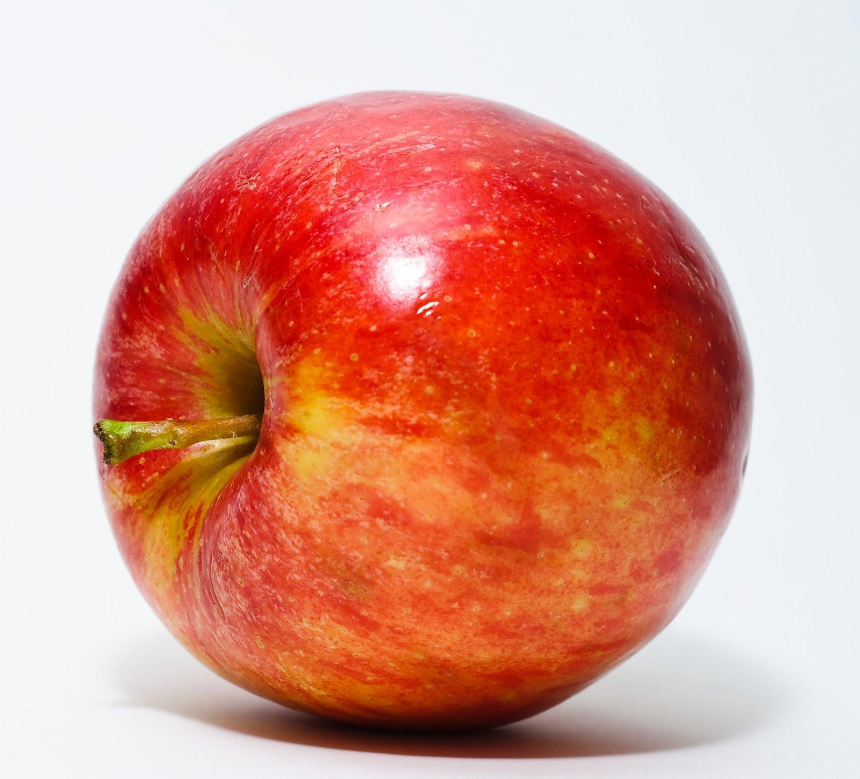
Object-Oriented Programming (2/2)
OOP emphasizes objects, which often reflect real-life objects
have both properties and capabilities
i.e., they can perform tasks: “they know how to…”
Look around you… name that object!

Slide 16
OOP as Modeling (1/3)
In OOP, model program as collection of cooperating objects
program behavior determined by group interactions
group interactions determined by individual objects
In OOP, objects are considered anthropomorphic
each is “smart” in its specialty
e.g., bed can make itself, door can open itself, menu can let selections be picked
but each must be told when to perform actions by another object - so objects must cooperate to accomplish task

Slide 17

OOP as Modeling (2/3)
Each object represents an abstraction
a “black box”: hides details you do not care about
allows you as the programmer to control programs’ complexity - only think about salient features

Slide 18
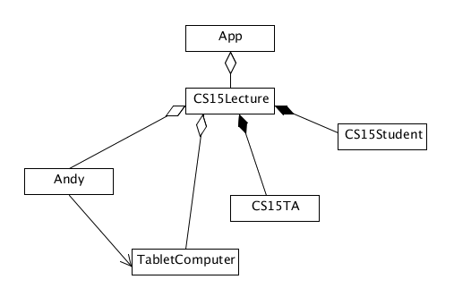
OOP as Modeling (3/3)
So, write programs by modeling the problem as system of collaborating components
you determine what the building blocks are
put them together so they cooperate properly
like building with smart Legos, some of which are pre-defined, some of which you design!
containment diagrams, like the one shown here, is a great way to help model your program!
Professor

Slide 19
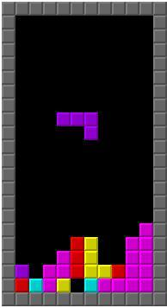
Example: Tetris (1/3)
What are the game’s objects?
What properties do they have?
What do those objects know how to do?

Slide 20
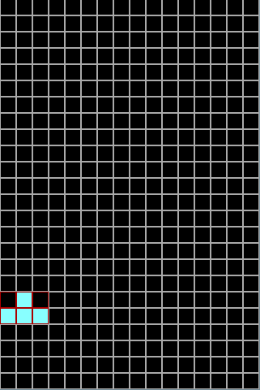
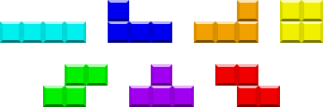
Example: Tetris (2/3)
What are the game’s objects?
piece, board
Properties: What attributes and components do they have?
piece
orientation
position
shape
color
tiles
board
size
rows

Slide 21
Example: Tetris (3/3)
Capabilities: What do those objects know how to do?
piece
be created
fall
rotate
stop at collision
board
be created
remove rows
check for end of game

Slide 22
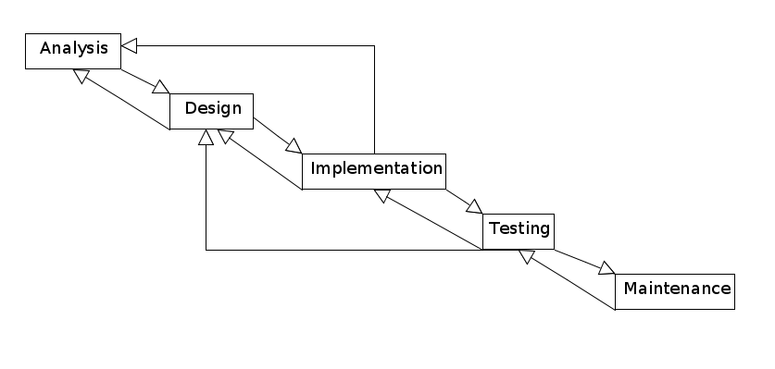
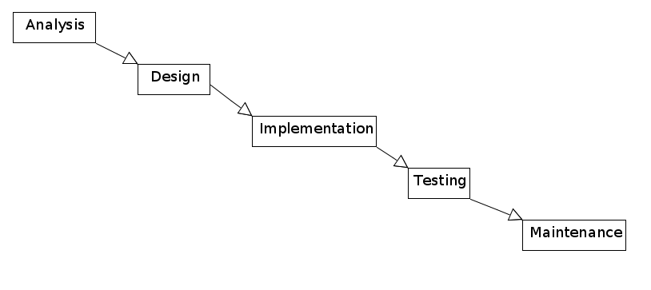
Software Development: A 5-Step Process (1/3)

Slide 23
Software Development: A 5-Step Process (2/3)
Analysis
English description of what the system models to meet user requirement/specification
Designing the system
“Divide et impera” - divide and conquer: system is composed of smaller subsystems which in turn may be composed of even smaller subsystems (diagrams often helpful)
Implementing the design (in Java for CS15)
if design is good, most of the hard work should be done
Testing and Debugging
testing: submitting input data or sample user interactions and seeing if program reacts properly
debugging: process of removing program bugs (errors)
Maintenance
in a successful piece of software, keeping a program working and current is often said to be 80% of the effort

Slide 24
Software Development: A 5-Step Process (3/3)
Good program
solves original problem
well structured, extensible, maintainable, efficient,… and met deadline and budget constraints…
Other developmental processes exist (e.g., extreme/agile programming)

Slide 25
Announcements (1/2)
If you are even considering taking the course, we need you to register (or add to cart) on CAB before Saturday (9/7) at 12am – our first lab starts the next Tuesday!​
Registration → account creation
Introductory sections will begin next week (~10 students per section). Section times will be your time for the entire semester, and selected on a first come first serve basis:​
Tuesday 5pm-6:30pm, 6:30pm-8:00pm, 8:00pm-9:30pm
Wednesday- 3:00pm-4:30pm, 4:30pm-6:00pm, 6:00pm-7:30pm, 7:30pm-9:00pm
Thursday- 12pm-1:30pm, 5:00pm-6:30pm, 6:30pm-8:00pm
By Sunday morning, we will email you instructions on registering for a lab section, so check your email!​

Slide 26
Announcements (2/2)
We will send a more detailed email about Top Hat this weekend
RISD and other non-Brown students please come speak to an HTA or Andy after class
HTAs hours this weekend in CIT 102
Saturday 10-11:30am, Sunday 6-7:30pm
Check the course website at http://www.cs.brown.edu/courses/cs015 and your email regularly.​
If you are undecided about which CS intro course to take, this documents is a good reference:
https://cs.brown.edu/degrees/undergrad/whatcourse/

